Slide 1
Recap of the Facility Assessment
The facility assessment for Knox Community School Corporation is a collection of data and information about each of the buildings in the corporation.
The assessment identifies deficiencies in each of the buildings and assigns a value to them so they can be ranked from bad to good.
2017-163

Slide 2
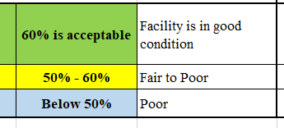
Recap of the Facility Assessment
We have color coded the assessment values.
A score of 60% or above is a good rating, and most of the components identified fall into a maintenance category. We have assigned green to this group.
A score between 50% and 60% reflects a combination of maintenance items as well as systems and materials that, because of their age are in need of repair or replacement. This group is colored yellow.
A score that falls below 50% has many components that are failing. We have assigned blue to this category.
2017-163

Slide 3
Recap of the Facility Assessment
The ranking, in conjunction with the gross area, is used to project a potential cost to correct the items identified.
But, there are a few more things to consider, such as…
The utilization of space
The size of the site
The age of the building
The comments from the staff!
2017-163

Slide 4
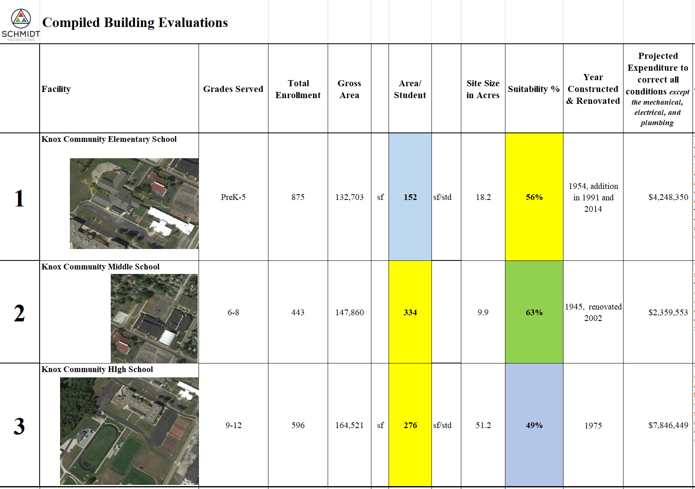
Recap of the Facility Assessment
Starting with the summary sheet, we will look at each building and compare the overall suitability score and corresponding projected costs to correct the identified deficiencies.
The potential costs reflect the extent of potential correction required, but do not include the costs associated with the necessary corrections of the mechanical, electrical, or plumbing systems.
Keep 31,000
Gym

Slide 5
Recap of the Facility Assessment
To be able to explore the effective utilization of the facility, we identified the grade levels served as well as the number of students in the facility. Using the gross area, we are able to calculate the area per student.
This number provides a basis that can be compared to state wide and national metrics to identify effective utilization of a K-12 educational facility.
Keep 31,000
Gym

Slide 6
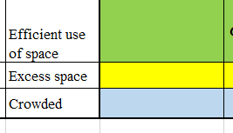
Recap of the Facility Assessment
We need to look at the effective utilization of the building to see if it falls within state and national metrics for square footage per student.
This will be an initial indicator of whether there is not enough space for the student population or if there is potentially excess space.
Building Type Grade Level Square Foot/Student
Elementary Pre K-5 170 sq.ft./student
Middle School 6 - 8 180 sq.ft./student
High School 9 – 12 250 sq.st./student
Keep 31,000
Gym
The table above represents typical utilization numbers across the state, and we have developed a color key for the assessment.
We can use these numbers and compare them to the facilities at Knox Community Schools.

Slide 7
Recap of the Facility Assessment
The size of the site is important in the evaluation of everything from potential expansion of the facility to the opportunities to reconfigure the flow of buses, cars, and walkers.
In the past, the Indiana DOE had rigid standards for the size of school sites that would push an elementary site to 15 acres, a middle school to past 20 acres, and a high school to 50 + acres.
Keep 31,000
Gym

Slide 8
Recap of the Facility Assessment
The age of a building is another indicator of potential viability. Even the most substantial structures have a functional lifespan, and the date of the original construction is a factor that should be considered in an evaluation of whether to “invest” in a facility or not.
Keep 31,000
Gym

Slide 9
Recap of Knox Elementary School
Keep 31,000
Gym

Slide 10
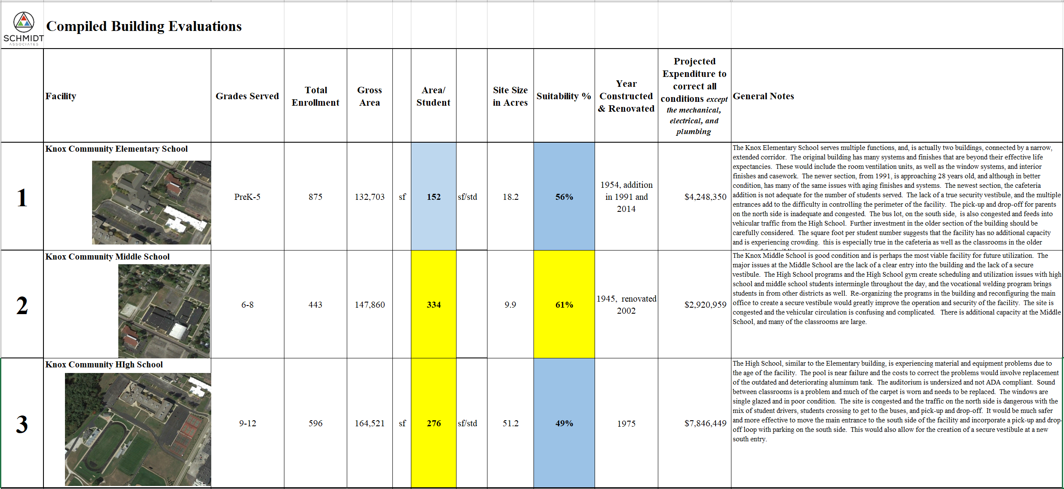
Recap of Knox Elementary School
Keep 31,000
Gym
Although the newer section of the building is in good condition, the older section has numerous conditions that require attention. Most are because of the age of systems or materials that are beginning to fail or need to be replaced.

Slide 11
Recap of Knox Elementary School
Keep 31,000
Gym
The square foot per student falls below the ideal average of 170 square feet/student.
Based on our assessment of space needs, we can identify the potential short-fall of space.

Slide 12
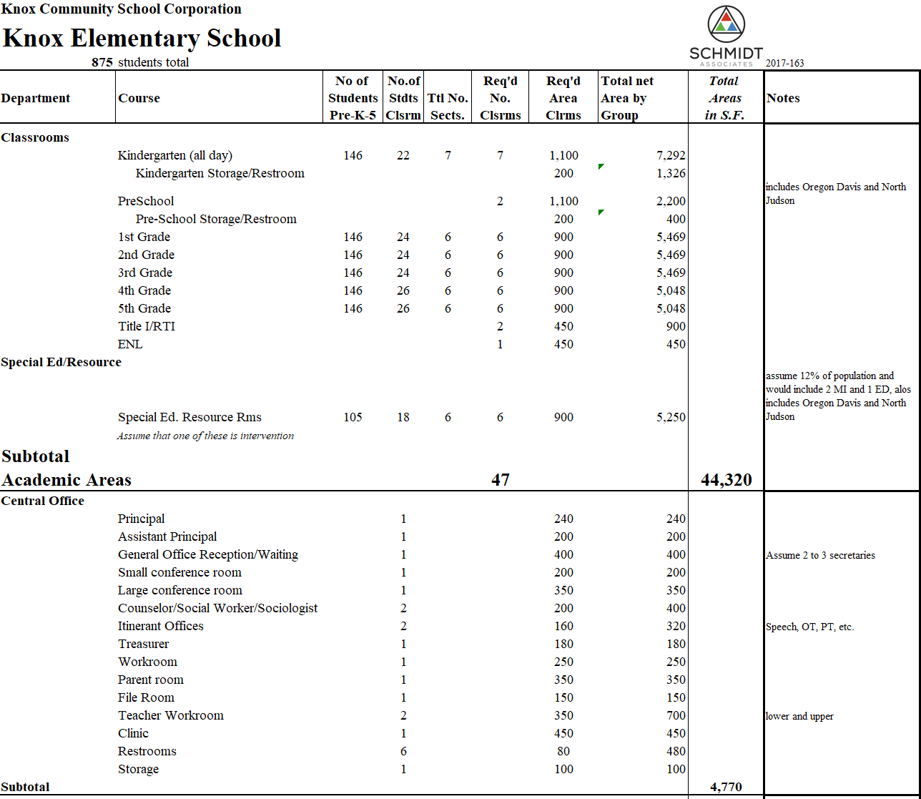
Recap of Knox Elementary School
Based on the current population of 875 students, we have projected the “ideal” number of classrooms, based on a loading factor of approximately 22 students per classroom for Kindergarten, 24 for 1st through 3rd and 26 for 4th and 5th.
We are assuming Kindergarten and pre-school rooms are 1,100 square feet + restrooms in the classrooms, and regular classrooms are 900 square feet.
We have assumed a special education population of 12% of the total, with a loading of 18 students per classroom.
We are able to project a total “Net” area for the current loading.
In the office area, we are reflecting what we understand to be housed in the office.
Keep 31,000
Gym

Slide 13
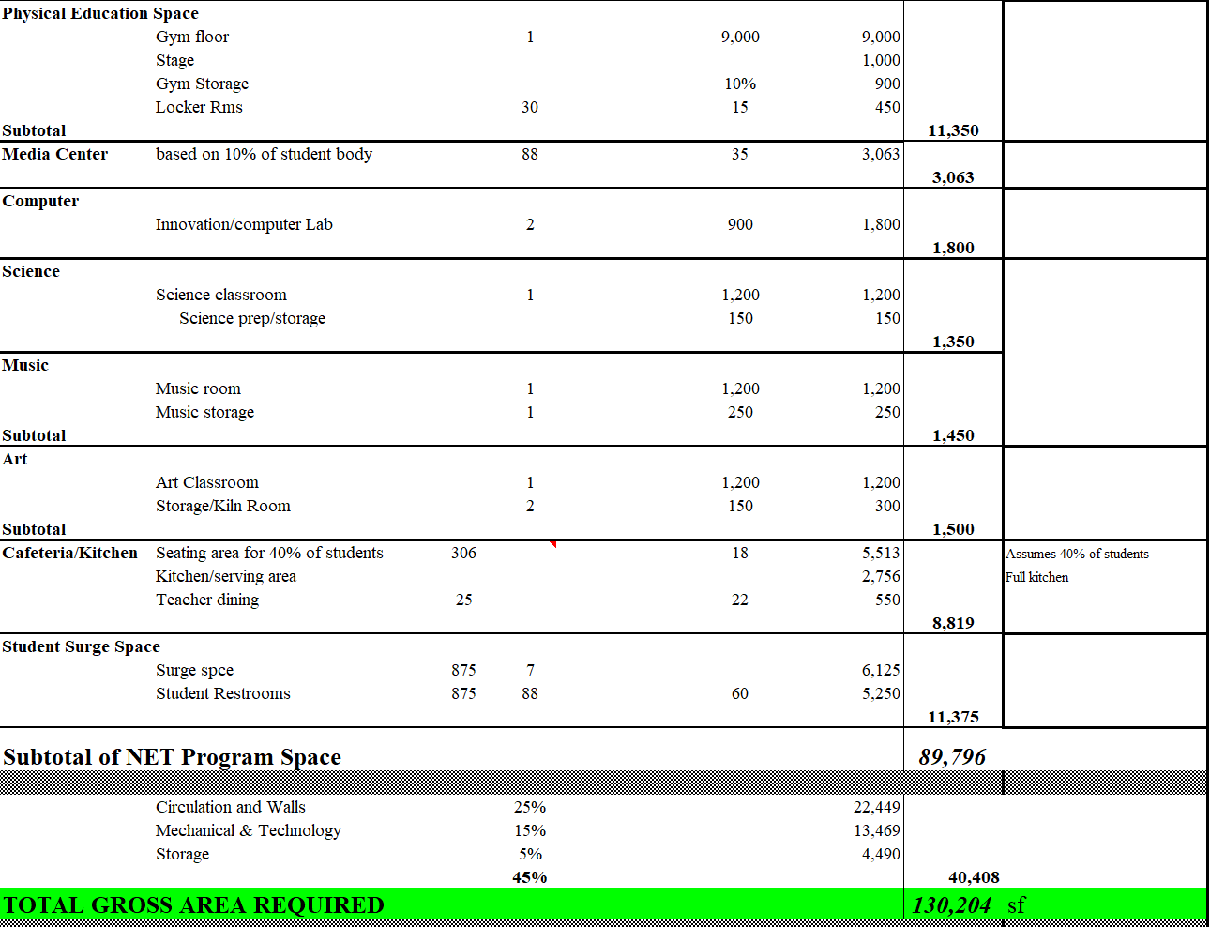
Recap of Knox Elementary School
We are projecting a “full sized” gym, since we know the middle and high schools would use the gym for additional practices, if possible.
The media center is projected to accommodate 10% of the students at one time.
We are projecting 2 – “Project based learning labs”… listed as computer labs.
We understand you have a “Science” special, as well as Music and Art.
The cafeteria is sized for 40% of the total student body.
The Surge space and Restroom area is a factored number.
This gives us a total “Net” area, to which we add an additional 45% to arrive at a projected Gross area of 130,204 square feet.
Keep 31,000
Gym

Slide 14
Recap of Knox Elementary School
The Actual area of the existing building is 132,703 sf.
BUT, we have to subtract the area of the Culinary arts program and the Superintendent’s Office and Board Room
Keep 31,000
Gym
The adjusted area is 122,703 square feet, resulting in a deficit of approximately 7,501 square feet.

Slide 15
Recap of Knox Elementary School
Keep 31,000
Gym
The site size would appear to be adequate, but the multiple entrances and congestion of pick-up and drop-off could be configured better.

Slide 16
Recap of Knox Elementary School
Keep 31,000
Gym
The two sections of the building have a broad spread of ages. The original building has many conditions that will require significant renovation or reconstruction, and the age of the building means that the envelope is not as energy efficient as the newer section, nor is there adequate space above the ceiling. The age of the plumbing under the slab is probably another factor that limits the viability of the original component.

Slide 17
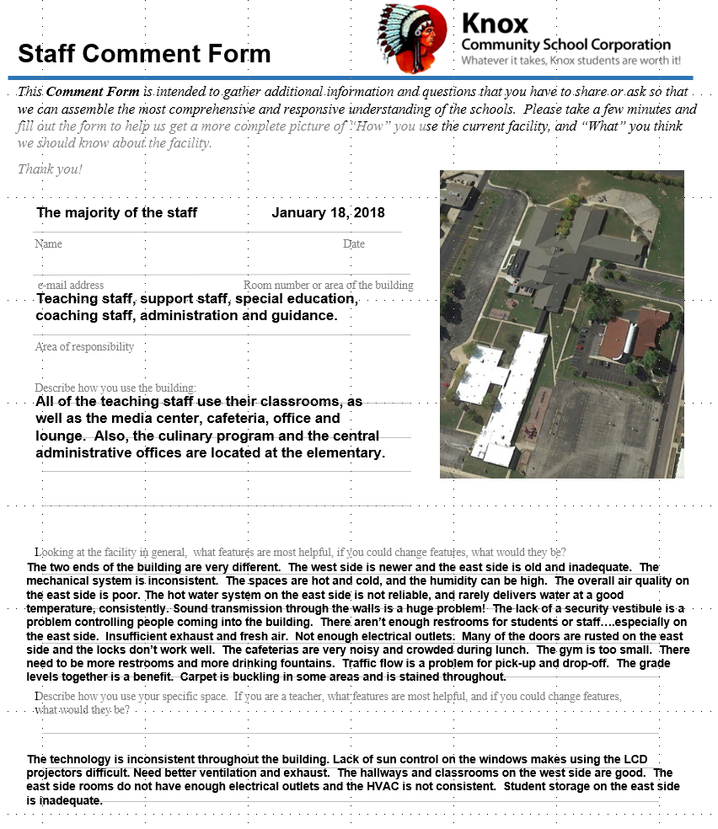
Recap of the Elementary School
What did the staff say at the Elementary School?
These questions ask what works well in the school, and what, if possible, would the staff change.
One of the most important issues was the lack of a secure vestibule, making it difficult to control who comes in the building and where they go once they get in. The other condition mentioned was the disparity of the conditions on the two sides of the building.

Slide 18
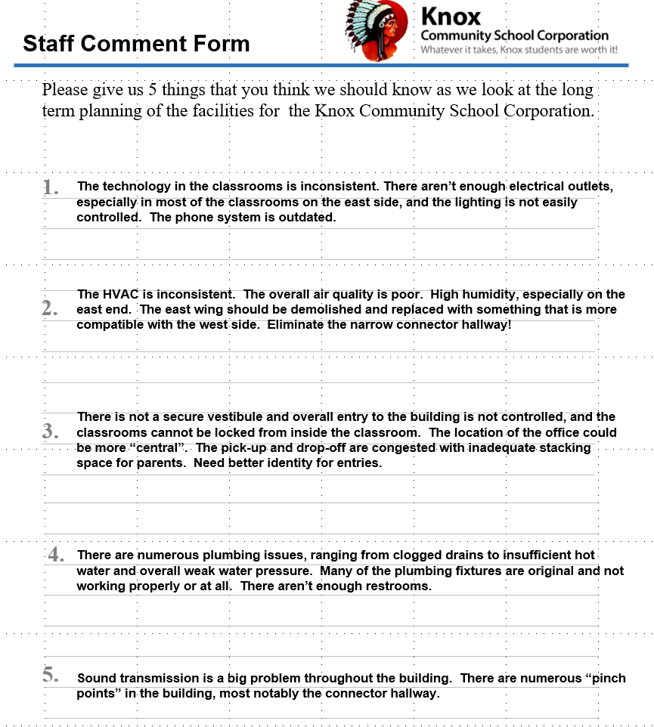
Recap of the Elementary School
What did the staff say at the Elementary School?
The comments validate the need to correct the HVAC system and controls.
The condition of the carpet and furniture.
There is no secure vestibule
The vehicular congestion on the site.
Sound control.
Keep 31,000
Gym

Slide 19
Recap of Knox Elementary School
Keep 31,000
Gym
The projected costs to correct the items noted, with the exception of the mechanical, electrical and plumbing is over $4 million. Of that we would project approximately 10% or $425,000 of critical items. These would include roof repairs, carpet and finishes, and site conditions. But, it would not adjust the size of the overall building or the size of the spaces, such as the lower elementary cafeteria.

Slide 20
Recap of Knox Middle School
Keep 31,000
Gym

Slide 21
Recap of Knox Middle School
Keep 31,000
Gym
The Middle School scored the highest of the 3 facilities. Although the original portion of the building dates from 1945, subsequent renovations and additions have resulted in a very usable and versatile structure.
Some of the most significant issues are the lack of a security vestibule to control visitors and parents entering the building during the day, and the condition of the pavement and drives in the parking lots.

Slide 22
Recap of Knox Middle School
Keep 31,000
Gym
The gross area per student is very high. Ideally, for a middle school this number should be closer to 180 square feet per student. The 334 square feet per student, suggests that there is additional capacity in the facility.

Slide 23
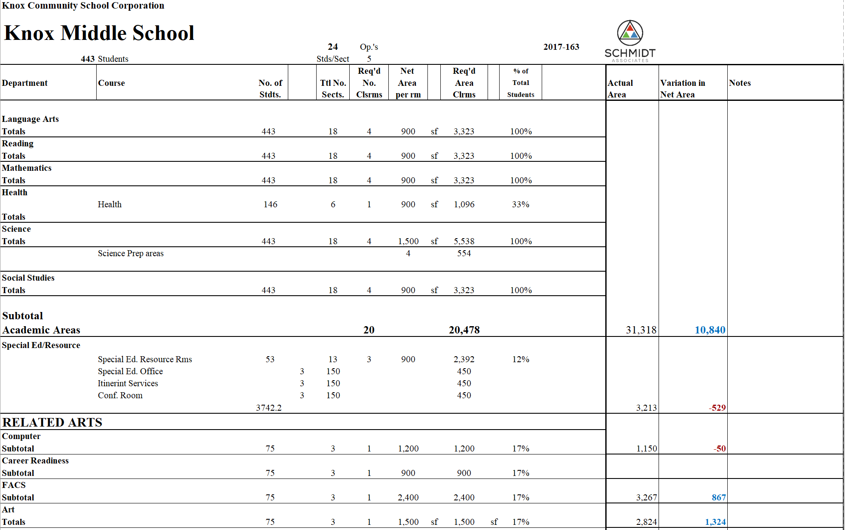
Recap of Knox Middle School
We used a similar approach when analyzing the Middle School, except we based it on a potential of 5 opportunities, over a 2 day period, with the specials shown.
We have assumed a Special Ed. population based on 12% of the student body.
We understand if a student is in band or choir, they are excluded from one of the elective specials.
Similar to the approach with the Elementary school, we were able to project “ideal” area of each activity space or educational space, and then calculate the “actual” and show if the actual is greater or less than the area required.
BLUE indicates that there is more space available than is required, and RED indicates a deficiency.

Slide 24
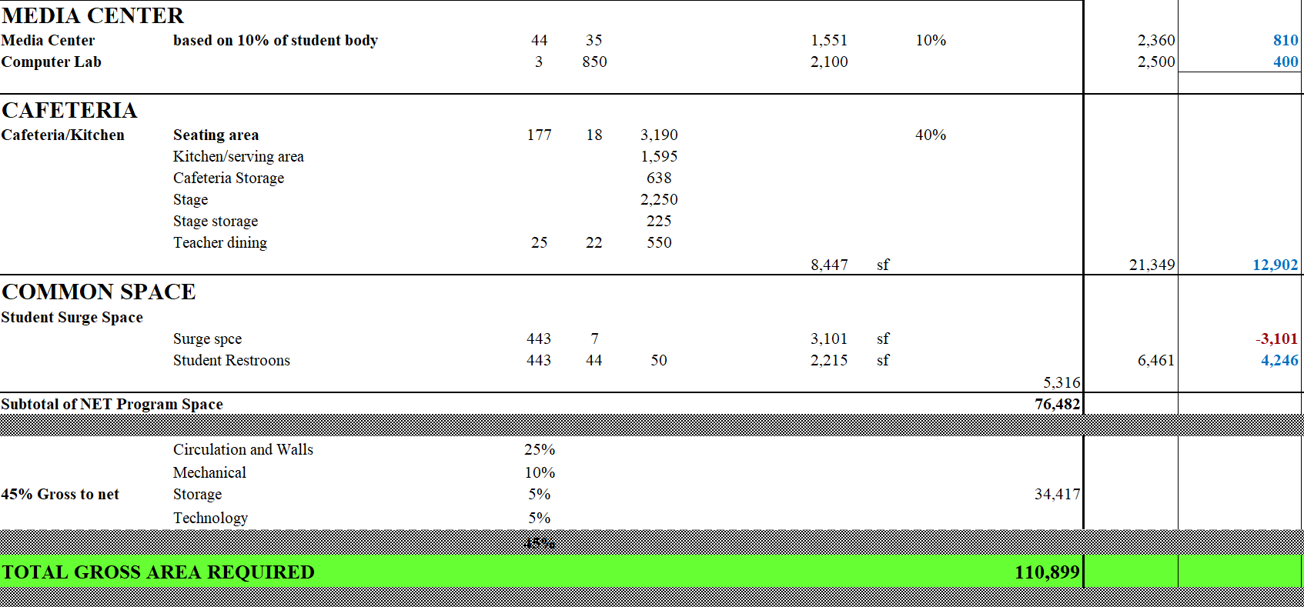
Recap of Knox Middle School
The media center is projected to accommodate 10% of the students at one time.
We are projecting 3 – “Project based learning labs”…listed as computer labs.
The cafeteria is sized for 40% of the total student body, because we have assumed 3 lunch periods based on the “block schedule”.
The Surge space and Restroom area is a factored number.
This gives us a total “Net” area, to which we add an additional 45% to arrive at a projected Gross Area of 110,899 square feet.

Slide 25
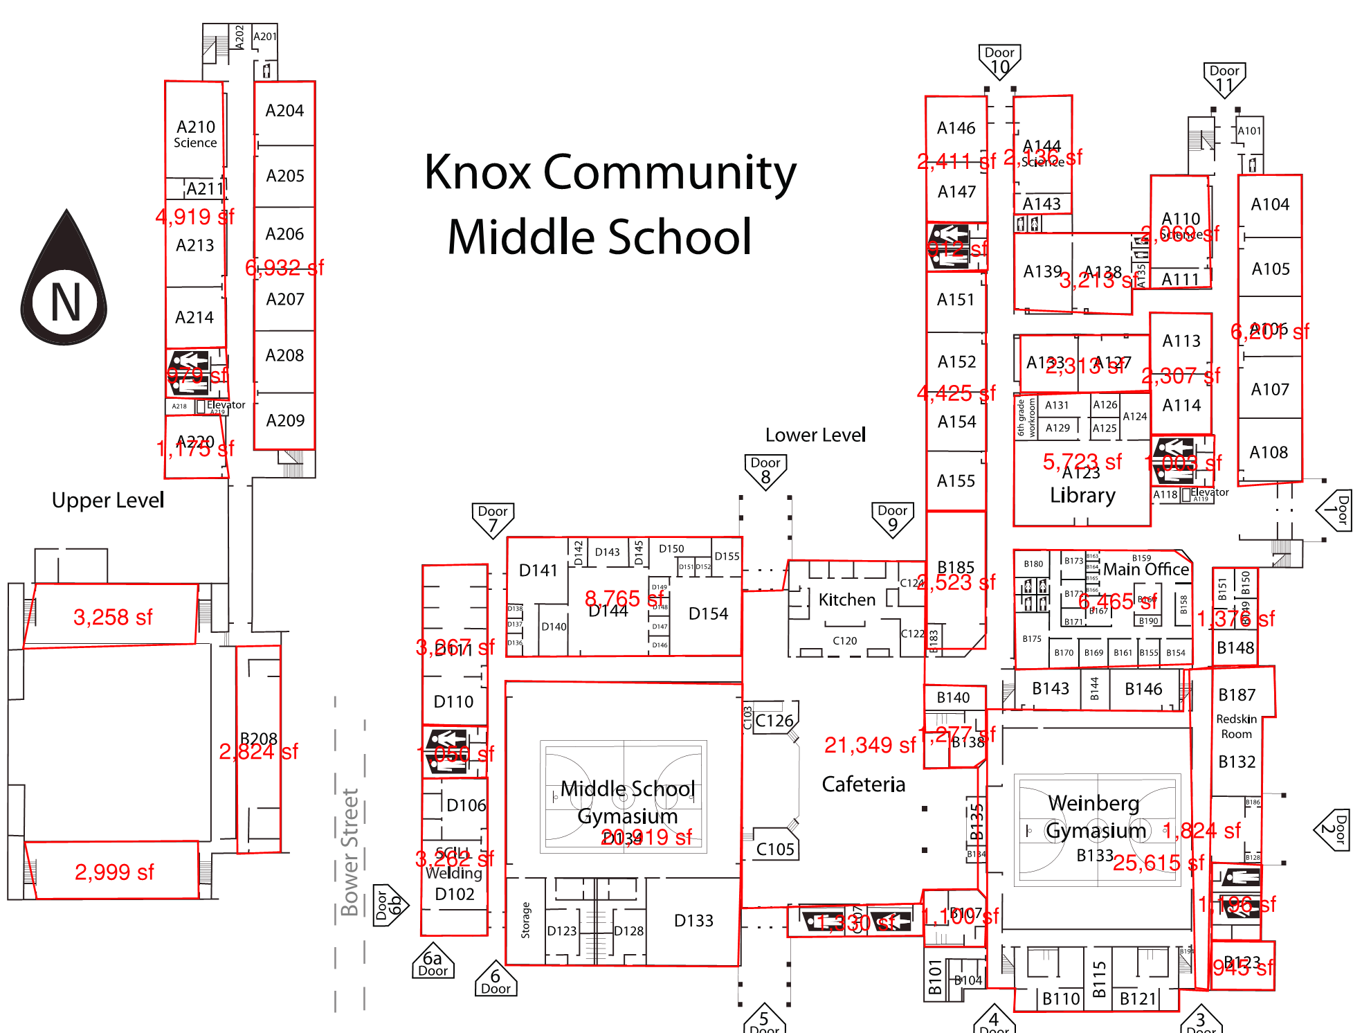
Recap of Knox Middle School
The Actual area of the existing building is 159,946 sf.
BUT, we have to subtract the area of the Weinberg Gym, the Welding Lab and the Redskin Room.
The resulting Gross Area is still large enough to accommodate the Middle School Program and actually shows an excess area of over 13,000 square feet.
The Gross Area/Student is also larger than the typical middle school factor of 180 – 200 sf/student.

Slide 26
Recap of Knox Middle School
Keep 31,000
Gym
The size of the site is small, and this is evident when you look at the congestion for pick-up, drop-off and parking overall.

Slide 27
Recap of Knox Middle School
Keep 31,000
Gym
Although the original building dates from 1945, the ongoing updates have resulted in a facility that is in overall very good condition.

Slide 28
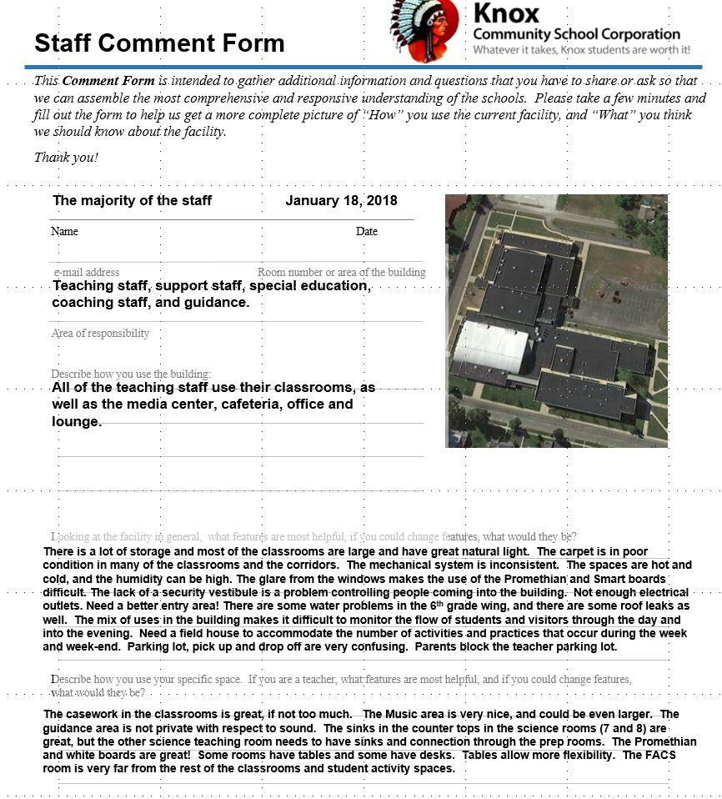
Recap of Knox Middle School
What did the staff say at the Middle School?
These questions ask what works well in the school, and what, if possible, would the staff change.
One of the most important issues was the lack of a secure vestibule, making it difficult to control who comes in the building and where they go once they get in. The other condition mentioned was the problems with the circulation and parking on the site, a well as mix of high school and middle school activity areas.
Keep 31,000
Gym

Slide 29
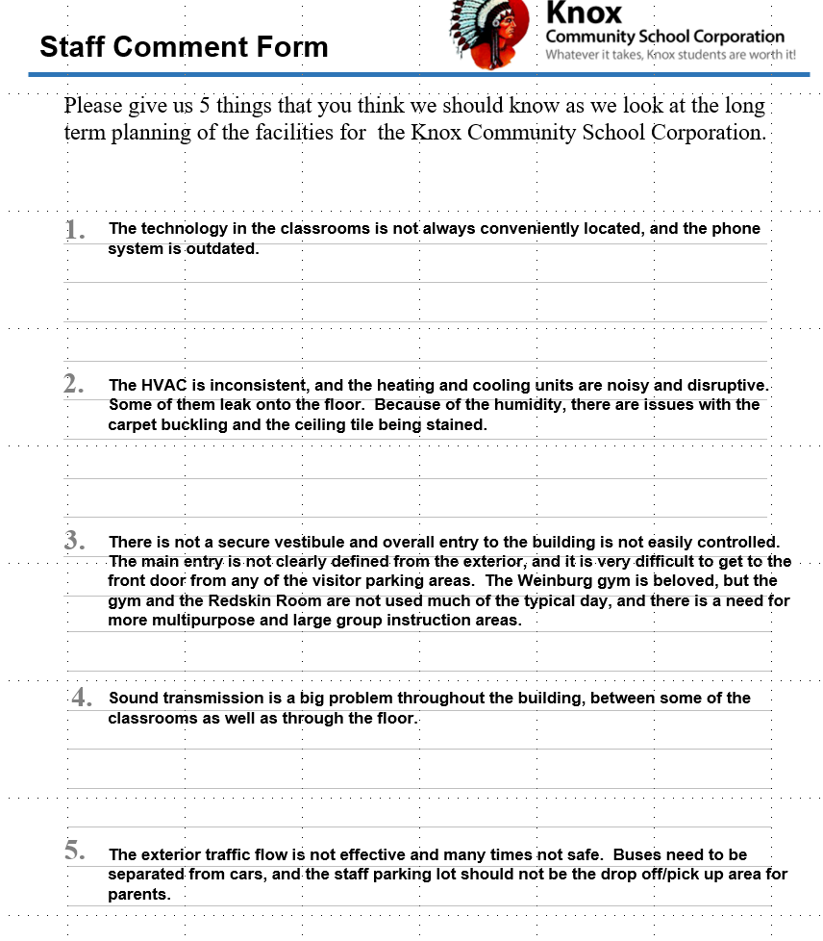
Recap of Knox Middle School
Keep 31,000
Gym

Slide 30
Recap of Knox Middle School
Keep 31,000
Gym
The projected costs to correct the items noted, with the exception of the mechanical, electrical and plumbing is approximately $2.4 million. Of that we would project approximately 10% or $240,000 of critical items. These would include creation of a secure vestibule, carpet and finishes, and site conditions.

Slide 31
Recap of Knox High School
Keep 31,000
Gym

Slide 32
Recap of Knox High School
Keep 31,000
Gym
The High School scored the lowest of the 3 Knox facilities.

Slide 33
Recap of Knox High School
There are issues with the exterior walls and water penetration, as well as the bowing of the exterior walls of the pool and gym that contribute to the ongoing deterioration of the exterior masonry.
Keep 31,000
Gym

Slide 34
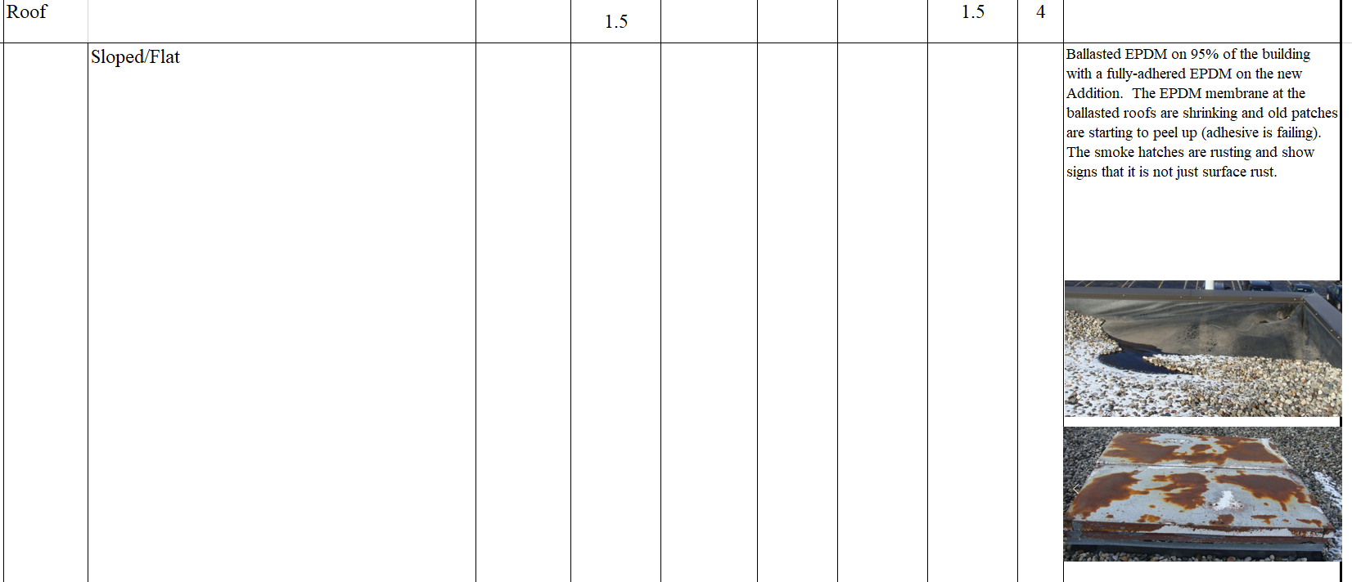
Recap of Knox High School
The aluminum pool tank is near failure, and the only alternative is to totally replace the pool and pool equipment.
The roof will need to be totally replaced as well.
Keep 31,000
Gym

Slide 35
Recap of Knox High School
Keep 31,000
Gym
The square foot per student is close to the ideal average of 250 square feet/student.
Based on our assessment of space needs, The square footage is not distributed effectively. Some areas are excessive, while other areas are cramped.

Slide 36
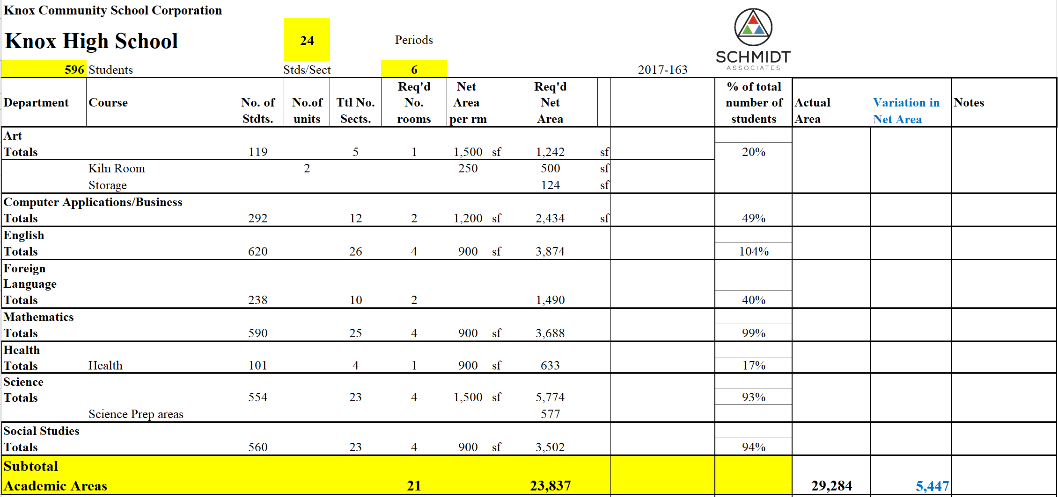
Recap of Knox High School
In the High School program, we have used the total number of students and then projected an idealized count based on a typical percentage of utilization to arrive at the total number of students per course, divided by 6 opportunities (3 per day) and 24 students/section.
Keep 31,000
Gym
Similar to the Middle and Elementary space needs analyses, we projected the “ideal” size of classrooms, based a typical Lab at 1,500 square feet and a typical classroom at 900 square feet.
And, we have been able to compare the “ideal” amount of space and compare it to what actually exists. Again BLUE indicates more space than what is required, and RED indicates a deficiency in space.

Slide 37
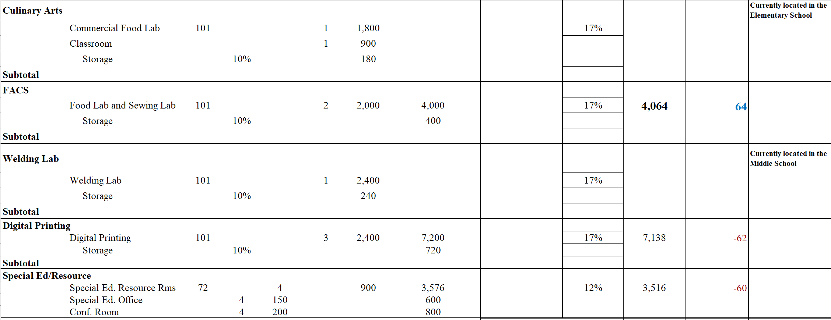
Recap of Knox High School
The related arts and specials were projected similarly.
And, similar to the Middle School and Elementary, we projected the “ideal size” of the classrooms and labs to accommodate the programs.
We have indicated that the Culinary Arts program is located in the Elementary and the Welding is located in the Middle School.
Keep 31,000
Gym

Slide 38
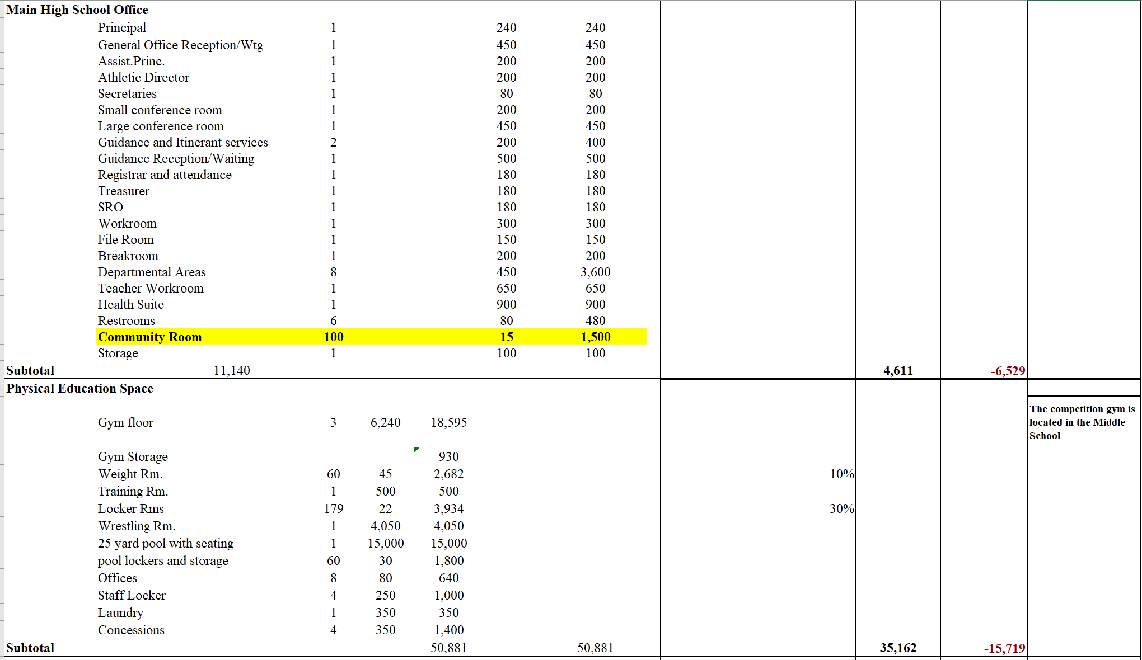
Recap of Knox High School
The office is a projection, based on assumed functions.
The P.E. and athletic spaces are based on current programs.
Note the Weinberg Gym is noted as being located in the Middle School.
Keep 31,000
Gym

Slide 39
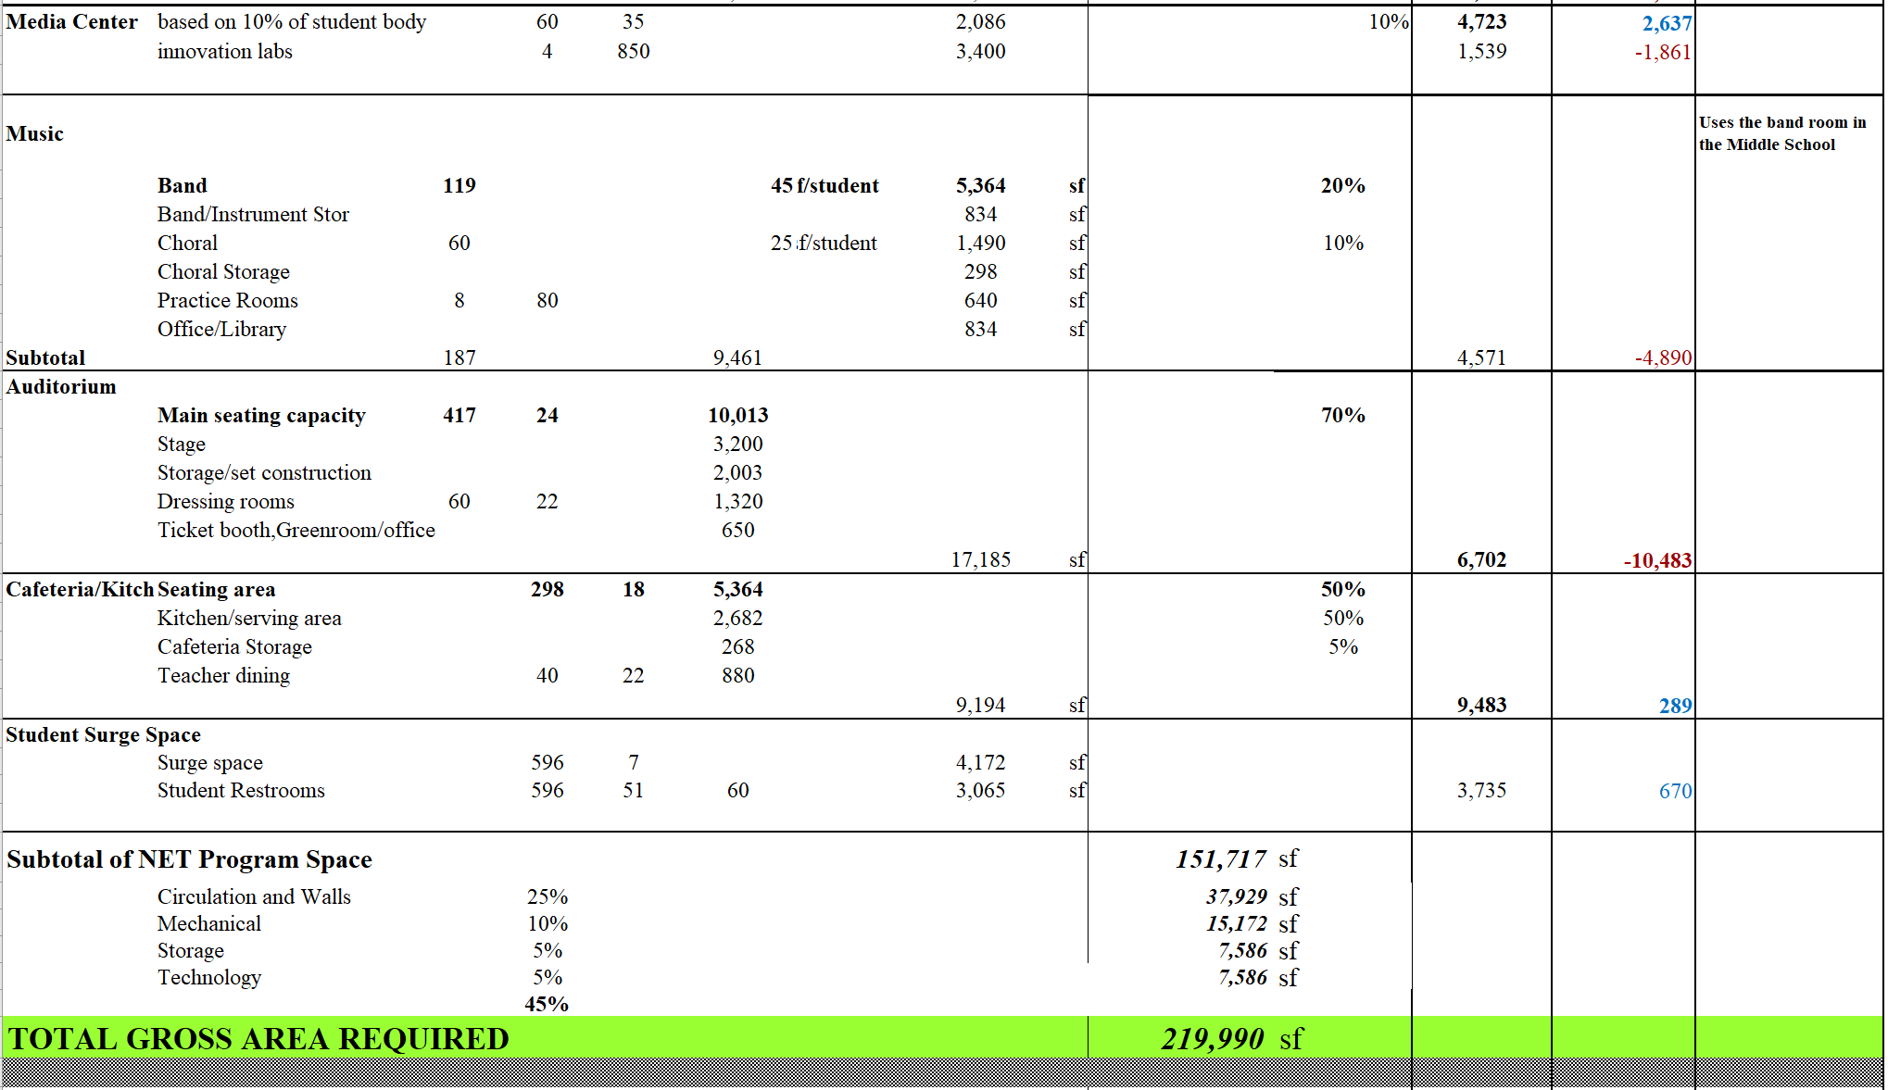
Recap of Knox High School
Band is sized for the current band size.
The cafeteria is sized for 50% of the total student body, because we have assumed 2 lunch periods based on the “block schedule”.
The Surge space and Restroom area is a factored number.
This gives us a total “Net” area, to which we add an additional 45% to arrive at a projected Gross area of 219,990 square feet.
Keep 31,000
Gym

Slide 40
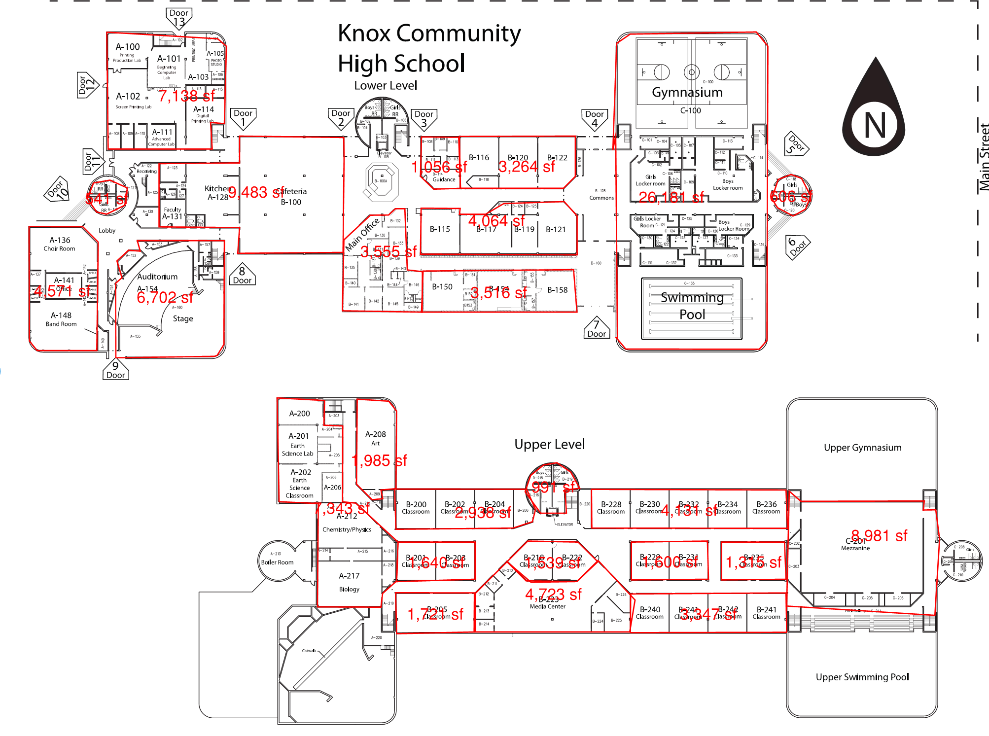
Recap of Knox High School
The Actual area of the existing building is 164,521 sf.
BUT, we know the Weinberg Gym, the Culinary Arts Program, the Welding Lab and the Redskin Room are not in this building!
The resulting Gross Area would not be large enough to accommodate all of the programs, and the deficit is larger than the projected area of the programs located in the other buildings.
Even though the square footages for these spaces are not part of the projected gross area, the “Ideal” Gross Area/Student is also almost 50% higher than the typical high school factor of 250 sf/student.
This is due, in part, to the number of vocational programs that are offered at the High School, and the proportionally small, total building enrollment number. The vocational programs require more space per student than a typical academic program, and create an imbalance of overall academic space.
Keep 31,000
Gym

Slide 41
Recap of Knox High School
Keep 31,000
Gym
The site size would appear to be adequate, but the congestion at the north entrances with parking, pick-up and drop-off could be configured better if the main entrance to the High School were moved to the area south of the building.
This would allow for better separation of cars and buses, as well as the potential for the creation of a new security vestibule into the main office.

Slide 42
Recap of Knox High School
Keep 31,000
Gym
The age of the facility explains, in part why parts and finishes in the building are deteriorating. Also, the fact that the main windows around the cafeteria are single pane is attributable to the time when energy and security were not major concerns in school buildings.
Main components, such as the pool have exceeded their lifespan, and the cost correct the failing systems will continue to drain capital funds.

Slide 43
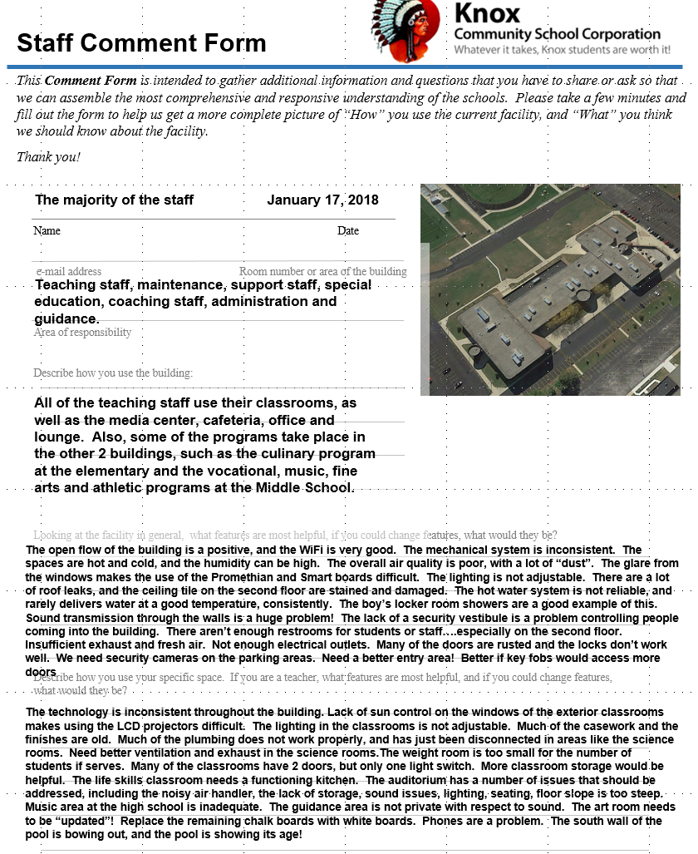
Recap of the High School
What did the staff say at the High School?
These questions ask what works well in the school, and what, if possible, would the staff change.
One of the most important issues is the lack of sound control between the classrooms, as well as the numerous leaks in the roof.

Slide 44
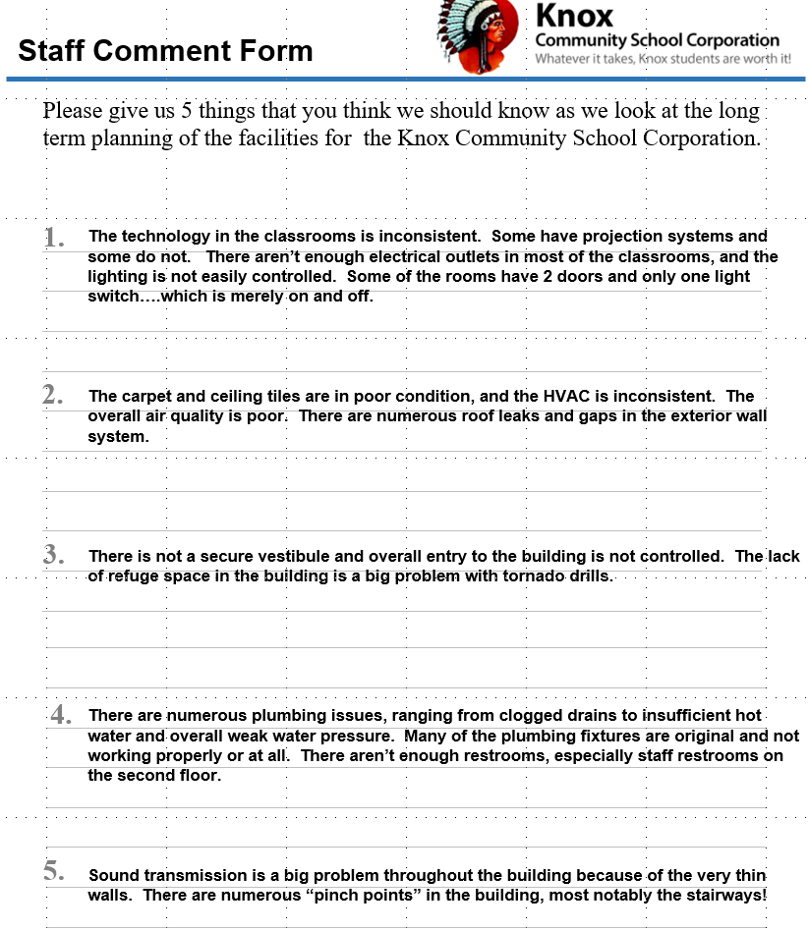
Recap of the High School
What did the staff say at the High School?

Slide 45
Recap of Knox High School
Keep 31,000
Gym
The projected costs to correct the items noted, with the exception of the mechanical, electrical and plumbing is approximately $7.8 million. In the case of the High School, we would project approximately 40% of this amount or $3.2 of critical items. These would include roof repairs, the pool, carpet and finishes, and site conditions. But, it would not adjust the size of the overall building or the size of the spaces.

Slide 46
The total cost of all of the items identified, excluding mechanical, electrical and plumbing corrections.
Compiling the projected costs
Assume a factor of 5% inflation because the actual work would probably be done a year from now.
Assume 20% in addition for associated soft costs.
The potential “Total Project Costs”

Slide 47
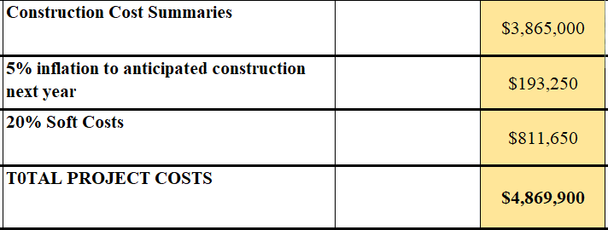
If we total what we would consider the “most critical items” from each of the buildings, excluding the cost of mechanical, electrical or plumbing, this would be:
Compiling the projected costs
Assume a factor of 5% inflation because the actual work would probably be done a year from now.
Assume 20% in addition for associated soft costs.
The potential “Total Project Costs”

